Slide 1
Contact Manager GUI Application
MUNEEB KHAN HAMMAD AYUB RAVI SHANKAR

Slide 2
AGENDA
INTRODUCTION
OBJECTIVES
PROJECT SCOPE
PROJECT PLAN
RESOURCES
CONCLUSION

Slide 3
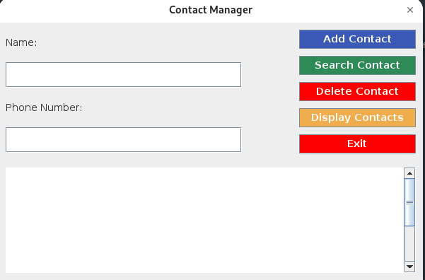
INTRODUCTION
LANGUAGE USED:
JAVA
OBJECTIVE:
Store And
Manage
Contacts
GUI: JAVA SWING

Slide 4
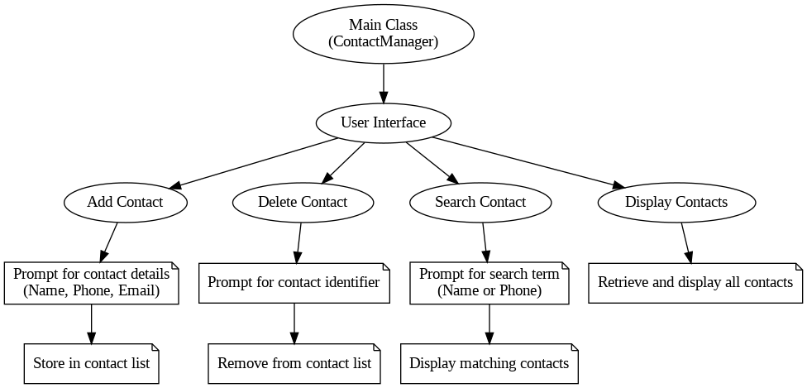

Slide 5
Data Structures And Algorithms Used
Tree Nodes
Recursion
Binary Search Tree (BST)
Each contact is stored in a TreeNode object
Utilized in operations like Add, Delete & Search
The core data structure used for managing contacts

Slide 6

CONCLUSION
Aim: Provide an efficient, user-friendly contact management tool
Structure: Detailed planning for timely and high-quality delivery
Benefits: Intuitive interface, core functionalities, and maintainability

